Slide 1
Accounts Payable, Travel Accounting and Export Controls
Overview of Export Controls
Restricted party screening for foreign payments
Sanctioned country travel reimbursement
Questions?

Slide 2
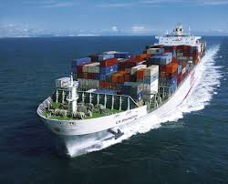
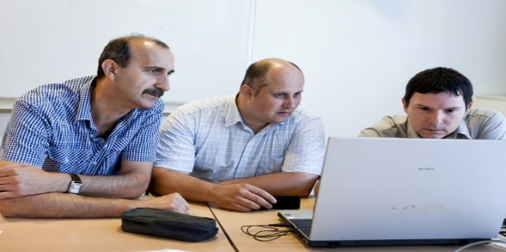
What are “export controls”
Federal laws and regulations that control the shipment, transmission or transfer of controlled items, information, software and services to specific individuals, entities and countries.

Slide 3
Why Does the Government Control Exports?
The government controls technologies it considers strategically important for:
National Security
Nuclear Non-Proliferation
Missile Technology Controls
Anti-Terrorism
Chemical & Biological Controls
Regional Stability
Crime Control Measures

Slide 4
Why This Matters…
Non-compliance can result in
Reputational harm
Loss of research funding or funds being frozen by bank
Penalties and fines - $250,000 to $1,000,000
Criminal offenses can result in imprisonment
Export controls may impact:
Participation by foreign national students, faculty, staff & visitors
Foreign collaborations
International shipments
Research in certain countries

Slide 5
Export Control Structure at UC
Export Control Officer(s)
Campus/Location
Designated by executive leadership at each UC Location.
Associate Director
UCOP/ECAS
Supports the implementation, assessment and continuous improvement of the Systemwide export control program.
Responsible for the monitoring and oversight of the local Export Control Compliance program.
Primary point of contact and subject matter experts at that location.
Responsible for reviewing the applicability of export control regulations.
Responsible for coordinating Systemwide communication and maintaining and disseminating regulatory information to UC Locations.
Serve as Empowered Officials responsible for ITAR compliance.

Slide 6
Risks
Restricted Equipment
Foreign Collaborations
International Field Research
Large Population of Foreign Visitors and Students
Export Control Risk Areas
Restricted Technology
Cutting Edge Research

Slide 7
Export Control Partners
Export Control Team
Contracts & Grants
Shipping
Gifts
Faculty, Researchers & Administrators
Tech Transfer
Purchasing
Audit
International Center & HR
Accounts Payable

Slide 8
Program Elements
Systemwide Policy
Processes/Systems for Review
Documented Procedures/Tools and Resources
Website and Communication
Training
Audits and Assessments
Record Keeping

Slide 9
Systems for Reviews
People
Foreign visiting scholars
Places
Foreign shipments
Foreign payments
Sanctioned countries transactions
Things
Procurement-purchasing
Contracts, grants, NDA’s, MTA’s and international agreements
Foreign national access to export restricted technology

Slide 10
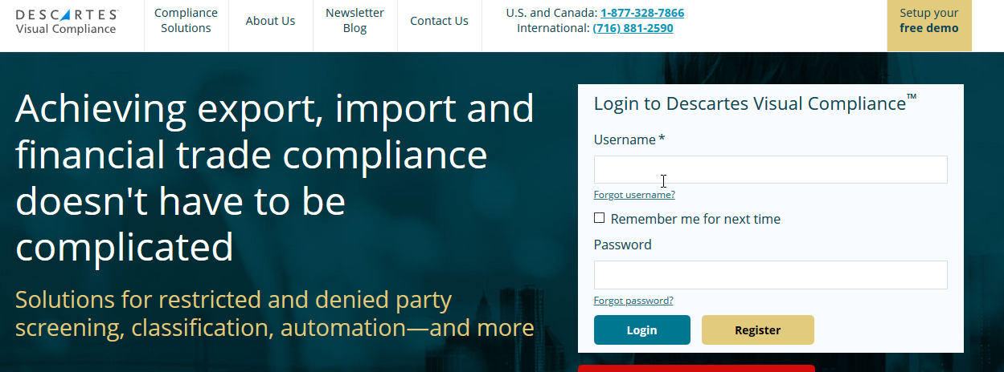
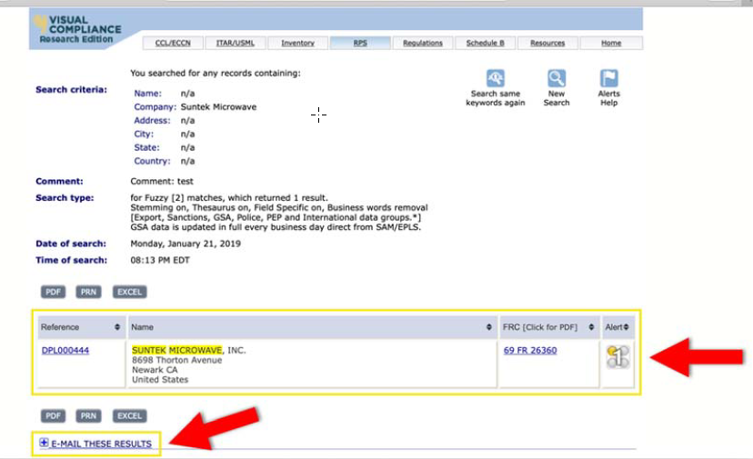
Restricted Party Screening
UC has a Systemwide license to Visual Compliance software.
Screens against federal restricted party lists
Provides a record that can be kept for record keeping purposes

Slide 11
Visual Compliance Software Report Capability
The ECO can run reports in Visual Compliance that will provide all screenings completed in a given time period allowing you to have a complete picture of the screening being done for your area.

Slide 12
Restricted Entity Lists
The U.S. government maintains a number of lists of federally sanctioned, debarred or restricted persons and organizations such as:
The Specially Designated Nationals and Blocked Persons List (U.S. Department of Treasury);
The Foreign Sanctions Evaders List (U.S. Department of Treasury);
The Entity List (U.S. Department of Commerce);
The Denied Persons List (U.S. Department of Commerce);
The Unverified List (U.S. Department of Commerce);
The Nonproliferation Sanctions List (U.S. Department of State);
The AECA Debarred List (U.S. Department of State).

Slide 13
Restricted Entity – examples
BEIJING UNIVERSITY OF AERONAUTICS AND ASTRONAUTICS (BUAA) AKA BEIHANG UNIVERSITY- China
NORTHWEST POLYTECHNICAL UNIVERSITY-Xian, China
SICHUAN UNIVERSITY- Chengdu, China
UNIVERSITY OF ELECTRONIC SCIENCE AND TECHNOLOGY OF CHINA - Chengdu, China
National University of Defense Technology- China
MALEK ASHTAR UNIVERSITY OF TECHNOLOGY- Tehran, Iran
BAQIYATTALLAH UNIVERSITY OF MEDICAL SCIENCES – Tehran, Iran
IMAM HOSSEIN UNIVERSITY- Tehran, Iran
BEN GURION UNIVERSITY (BGU)- Israel
Huawei technologies
*Not Comprehensive use visual compliance for screening

Slide 14
Transactions Involving Sanctioned Countries
United States sanctions programs are administered by the U.S. Department of Treasury, Office of Foreign Assets Control (OFAC), and impact our university activities.
The most restrictive sanctions programs (Cuba, Iran, North Korea, Sudan and Syria) prohibit U.S. Persons from:
A broad range of services and transactions that benefit or provide value.
Export of products, software, and transfer of technology.
Providing educational services and technical services, even where no monetary compensation occurs.

Slide 15
Sanctions Regulations Apply to U.S. Persons
U.S. Persons:
Any person within the U.S.
Any U.S. citizen or permanent resident alien, wherever physically located
Any entity or institution organized under U.S. law, including foreign branches
There are General Licenses for some activities and Specific Licenses can be obtained from OFAC in many cases, but terms must be strictly complied with.

Slide 16
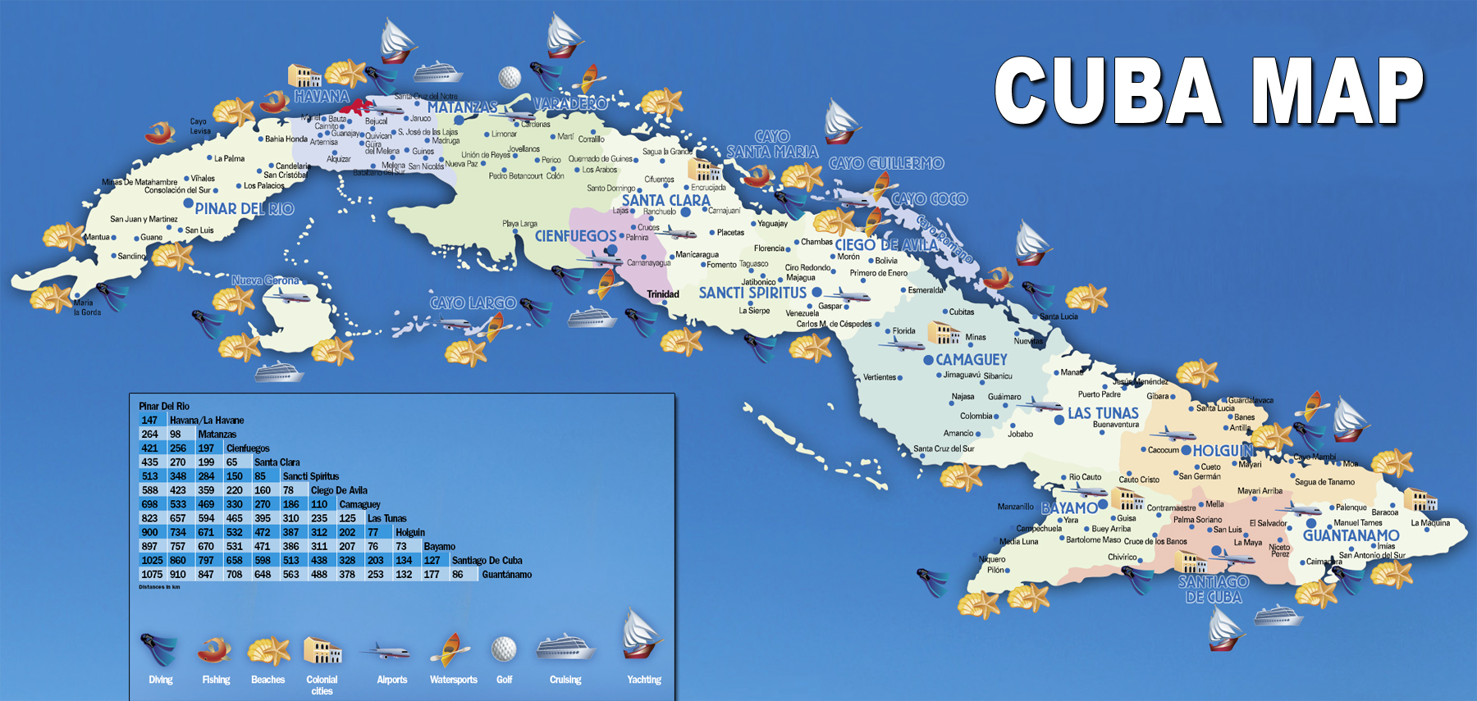
Travel to Sanctioned Countries and Reimbursement
Record keeping for five years is required by the regulations. What does this mean?
Cuba Example…

Slide 17
Action needed
Faculty, staff and students, contact the location Export Control Officer (ECO) for guidance as soon as possible (before the transaction), for any of the following, involving a comprehensively sanctioned country:
travel to (including to attend a conference)
transfer of funds to
any imports/exports (examples include research samples, artwork, or equipment)
collaboration with entities in a sanctioned country
research in
Best practices for travel accounting:
include this information in department level training on travel reimbursement
ECO review is triggered by travel accounting when a travel advance is requested and when departments are made aware of this requirement
post-travel ECO review is triggered by travel accounting through the reimbursement process to ensure that records related to review are available and maintained

Slide 18
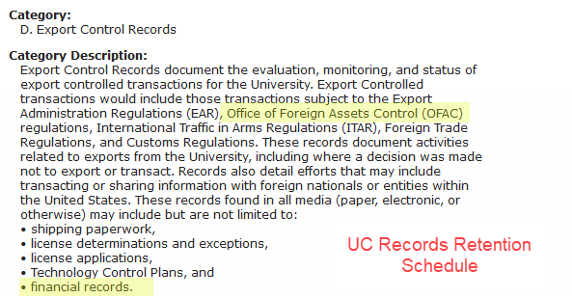
Export Control Record Keeping

Slide 19
Export Control Review Outcomes

Slide 20
Questions?
Contact the Export Compliance Office at exportcontrol@lbl.gov

