Slide 1
Export Control Tools
for Buyers

Slide 2
Welcome and Training Objectives
Familiarize with the following:
How U.S. export control regulations operate and impact higher education
Overview of Key Compliance Role of Purchasing
The actions necessary to purchase controlled items in a compliant manner
LBNL’s team approach to Compliance
Notes:
With the benefit of these tools and methods, buyers may simplify their tasks, avoid complications and are no longer “going it alone.”

Slide 3
Export Control Compliance has Many Roles
Export Controls
Travel
Purchasing
Accounts Payable
Equipment
Human Resources
Visa Services
Research
Sales & Service
International Shipments
Notes:
The field of export controls is complex and overwhelming. Fortunately no one need “go it alone.” There are many roles to play and export controls impact every department in different ways.

Slide 4
*** Contact the Export Compliance Office with questions concerning other agencies such as Energy and Nuclear Regulatory
EAR
Commerce
Dual Use Items
ITAR
State
Military Items
National Security
OFAC
Treasury
Sanctioned Countries
So… what ARE Export Controls for?
So… what ARE Export Controls for?
Export Control Regulations
Foreign Policy
Notes:
Export controls are intended to serve national security, foreign policy, nonproliferation, and short supply interests of the United States and, in some cases, to carry out its international obligations. Agencies such as the Department of Commerce’ Bureau of Industry and Security (BIS) controls the EAR. The State Department’s Directorate of Defense Trade Controls (DDTC) has jurisdiction over the ITAR. The Treasure Department’s Office of Foreign Assets Control has jurisdiction over Sanctions programs. These Agencies not only house the regulations but also enforce them.
Acronyms: Office of Foreign Assets Control (OFAC), Export Administration Regulations (EAR), International Traffic in Arms Regulations (ITAR)

Slide 5
Export Controls: What are they and what do they do?
U.S. Laws and Regulations which restrict:
The distribution of technologies, equipment, hardware and software; and
The provision of technical assistance to foreign nationals, foreign countries and listed individuals & entities; and
Payments and services to listed individuals, entities, and comprehensively sanctioned countries for reasons of foreign policy and national security.

Slide 6
Commodity Classification
ITAR vs EAR?
EAR 99?
Notes:
Most purchased items will be unrestricted as far as who may access them from a foreign person status. However, gatekeepers need to be ever mindful of red flags which need to be escalated for a closer determination. The UC’s purchasing terms require vendors to notify us if any of the goods are controlled (see Art 17 F). Most items fall under a commodity classification known as an Export Control Classification Number, or ECCN.

Slide 7
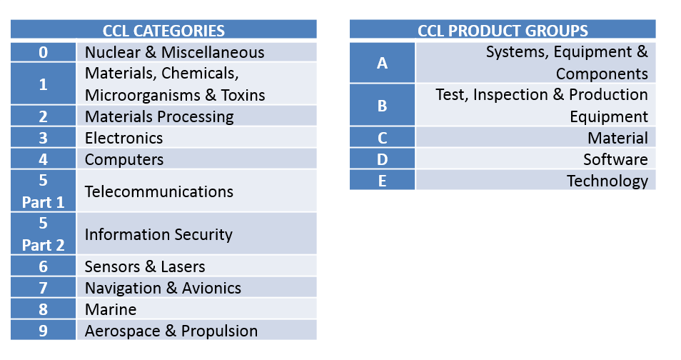
6A002/EAR 99
Items have an Export Control Classification Number (ECCN) containing
5 alpha-numeric characters
Example ECCN: 0A981
(‘Equipment designed for the execution of human beings . . .’)
Notes:
Items have an Export Control Classification Number (ECCN) containing
5 alpha-numeric characters Examples are 3A001, 1C351, 0A981
Examples of Dual Use (non-ITAR but subject to the EAR) ECCN’s are 6A003/6A002 and EAR 99.
Or 9A012 for certain UAV/UAS’s (drone systems).

Slide 8
EAR 99
ALTERNATE Slide
Items have an Export Control Classification Number (ECCN) containing
5 alpha-numeric characters
Example ECCN: 0A981
(‘Equipment designed for the execution of human beings . . .’)
Notes:
Items have an Export Control Classification Number (ECCN) containing
5 alpha-numeric characters Examples are 3A001, 1C351, 0A981
Examples of Dual Use (non-ITAR but subject to the EAR) ECCN’s are 6A003/6A002 and EAR 99.
Or 9A012 for certain UAV/UAS’s (drone systems).
Per the BIS List of EAR99 Medical Devices Exporter Guidance: The items listed below have been classified as EAR99. CT, PET or MRI scanners) that do not contain nuclear or chemical components
One-year specific license applications must be submitted to OFAC for export or reexport to certain restricted destinations.

Slide 9
ITAR – military use
XII (c)
Notes:
All thermal imaging is not alike. ITAR items are identified under the US Munitions List. ITAR items carry severe restrictions even for who may look at them. Written documentation about them should also be considered restricted. An ITAR Unmanned Aerial System (UAS) for example isn’t merely one item, but restrictions apply to components which may include Thermal Imaging Tubes, Inertial Navigation Measuring Units, Fire Control targeting systems, military electronics, and more. Any military purpose items or technology must immediately be flagged and escalated.

Slide 10
Notifications which identify Controlled Items? Check the fine print
“Buyer is responsible for compliance….with U.S. export control laws and regulations….”
“Buyer is responsible for compliance….with U.S. export control laws and regulations….”
Notes:
Make note of any contract terms which mandate export control obligations. Words or phrases requiring “Compliance with Export Control Regulations” or imposing restrictions against “Exports” or “Re-Exports” or seeking attestations or “End-Use statements” should be carefully vetted for escalation. Even references to “Embargoed Countries” should be carefully reviewed.
Vendors may state that the terms are standard terms but this may not be appropriate for universities. It is common to reach out to your local export control office and ask about unusual language or verbiage.

Slide 11
The UC’s New 3 Step Approach

Slide 12
Step 1
Follow the
Red Flags

Slide 13
What are Red Flags?

Slide 14
Step 2 Ask the right questions
Defense Article?
Dual Use? Controlled Under the EAR?
ECCN?
Military or Restrictive Non-Civilian Purpose?

Slide 15
Step 3 Follow the Decision Tree

Slide 16
Scenarios:
Vendor won’t provide control status
ITAR Items are accepted into Inventory
End-User wishes to return item to foreign source

Slide 17
How do institutions get In trouble?
Ignore Export Control Terms & Conditions
Fail To escalate concerns and Red Flags
Receive Controlled Technology without solutions such as Technology Control Plans
Fail to apply for licenses for licensable Activities

Slide 18
Questions?
Contact the Export Compliance Office at exportcontrol@lbl.gov

